Slide 1
TRAVEL PLANNER AI agent
IBM FDP
Faculty Name : Dr. R. Julian Menezes
College Name & Department : Vel Tech Rangarajan Dr.Sagunthala R&D Institute of Science and Technology & CSE

Slide 2
OUTLINE
Problem Statement
Technology used
Wow factor
End users
Result
Conclusion
Git-hub Link
Future scope
IBM Certifications

Slide 3
Problem Statement
A Travel Planner Agent is an AI-powered assistant that helps users plan trips efficiently and intelligently.
It uses real-time data to suggest destinations, build itineraries, and recommend transport and accommodation options.
By understanding user preferences, budgets, and constraints, it tailors personalized travel plans.
Integrated with maps, weather updates, and local guides, it ensures a smooth travel experience.
The agent can also manage bookings, alert users to changes, and optimize schedules on the go. This smart assistant transforms complex travel planning into a seamless, enjoyable process.

Slide 4
Technology used
IBM cloud lite services
IBM Granite model

Slide 5
IBM cloud services used
IBM Cloud Watsonx AI Studio
IBM Cloud Watsonx AI runtime
IBM Cloud Agent Lab
IBM Granite foundation model

Slide 6
Wow factors
This Travel Planner Agent transforms trip planning into a personalized, intelligent, and proactive experience. Beyond simply suggesting destinations, it acts as a real-time travel concierge, adapting to changes and optimizing every detail on the go.
Unique features:-
Dynamic Itinerary Optimization – Reacts instantly to weather, traffic, or flight delays and auto-adjusts schedules to keep trips smooth.
Hyper-Personalized Recommendations – Learns from user behavior and preferences (budget, activities, comfort level) to suggest unique, offbeat experiences rather than generic lists.
Budget-Aware Smart Planning – Tracks expenses against a live budget and proposes alternatives (cheaper flights, better hotel deals) without compromising user preferences.

Slide 7
Wow factors
Augmented Local Insights – Integrates real-time maps, curated guides, and cultural highlights so travelers experience the “hidden gems” of each destination.
Booking & Alerts Integration – Proactively manages bookings, monitors cancellations or delays, and notifies users with alternatives before problems disrupt the trip.
Collaborative Trip Planning – Enables group travel by merging preferences of multiple travelers, resolving conflicts (e.g., one loves museums, another prefers food tours) into a balanced itinerary.
Seamless Multimodal Experience – Accessible via chat, voice, and mobile web, ensuring continuity across devices and travel phases.

Slide 8
End users
Individual Travelers – Solo explorers seeking personalized, hassle-free trip planning.
Families & Group Travelers – Users who need collaborative trip planning that balances diverse preferences.
Business Travelers – Professionals requiring optimized schedules, reliable bookings, and real-time alerts for meetings/conferences.
Travel Enthusiasts & Bloggers – Content creators who want unique, curated local experiences and streamlined itineraries.
Corporate Travel Desks & Agencies – Teams managing employee travel, looking for cost-effective, automated planning solutions.
Educational/Student Travel Programs – Universities or institutions organizing study tours, exchange programs, or cultural trips.
Tour Operators & Hospitality Providers – Businesses that can integrate with the agent to offer smarter packages and targeted recommendations.

Slide 9
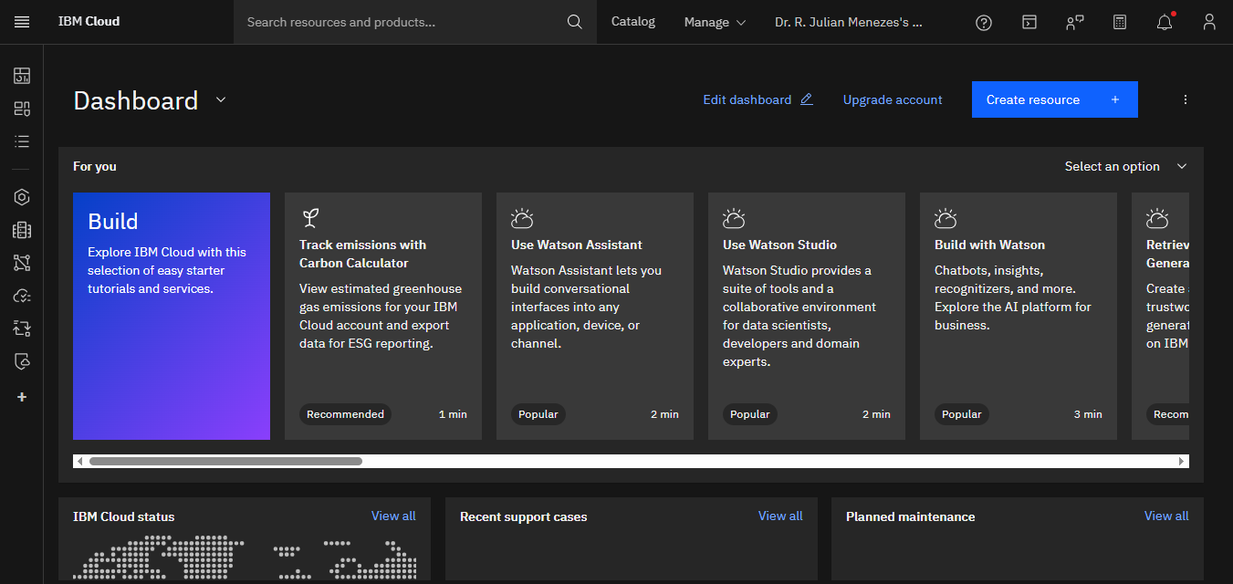
Results

Slide 10
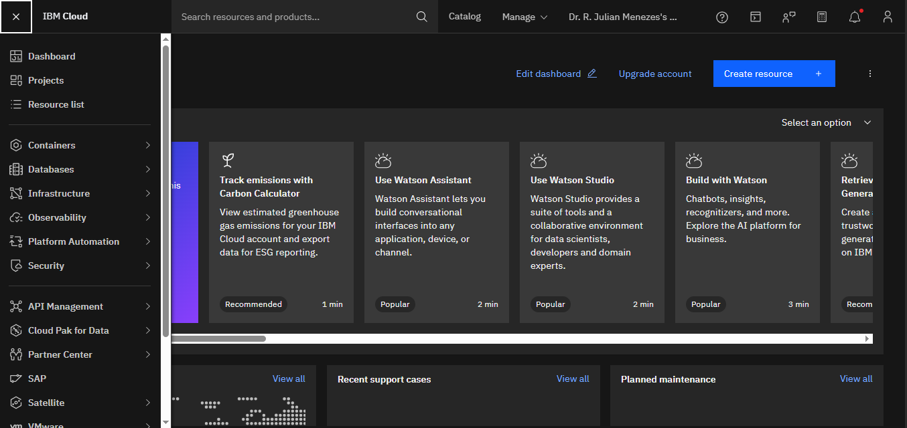
Results

Slide 11
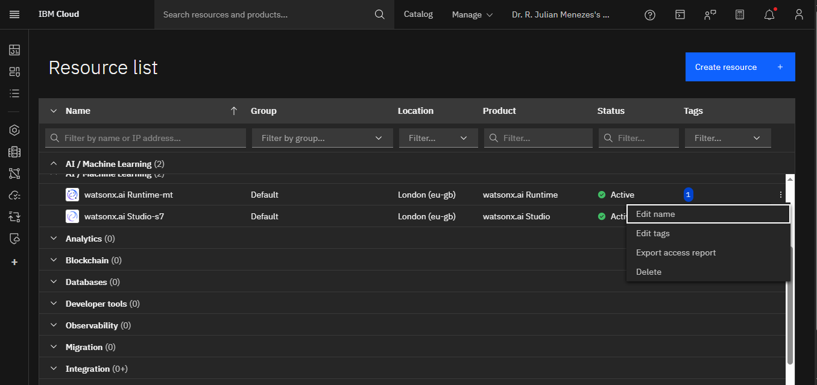
Results

Slide 12
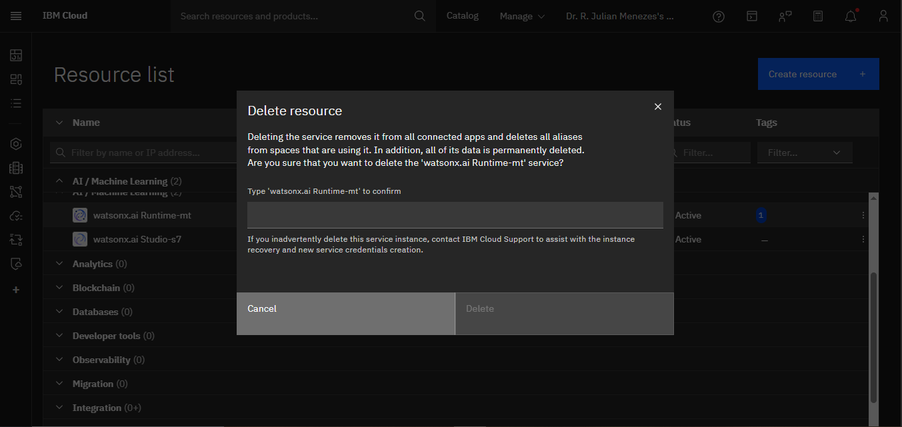
Results

Slide 13
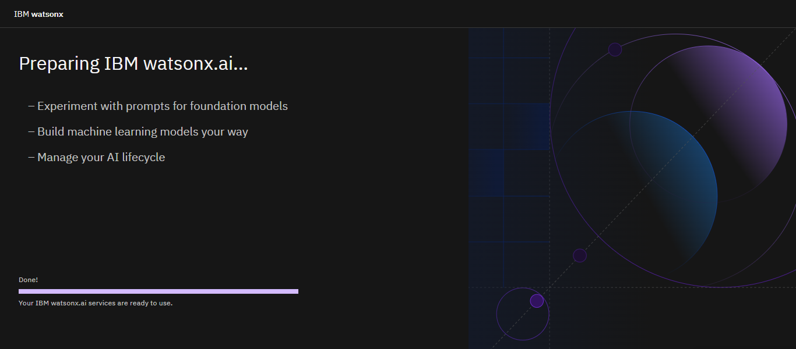
Results

Slide 14
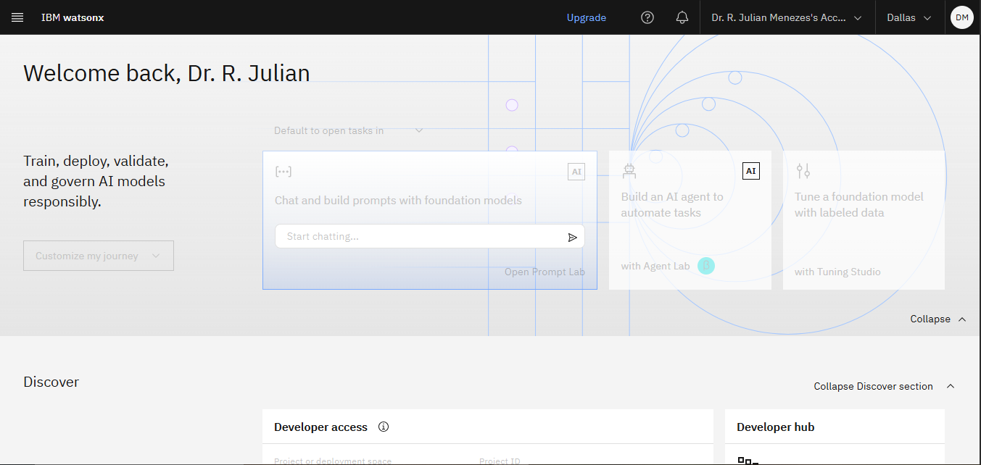
Results

Slide 15
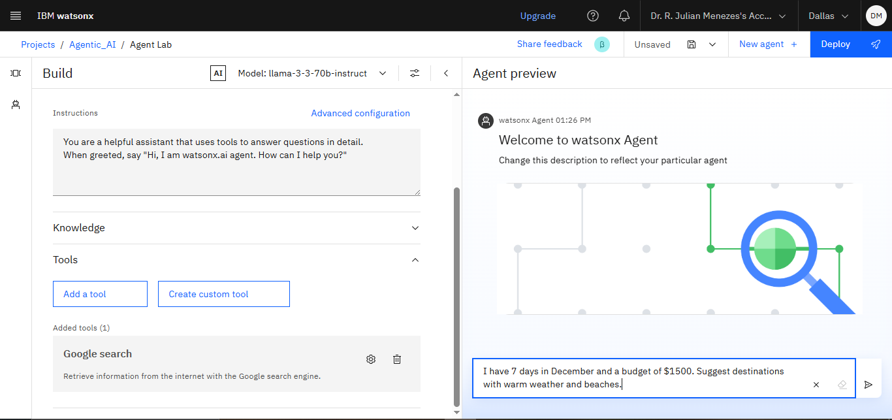
Results

Slide 16
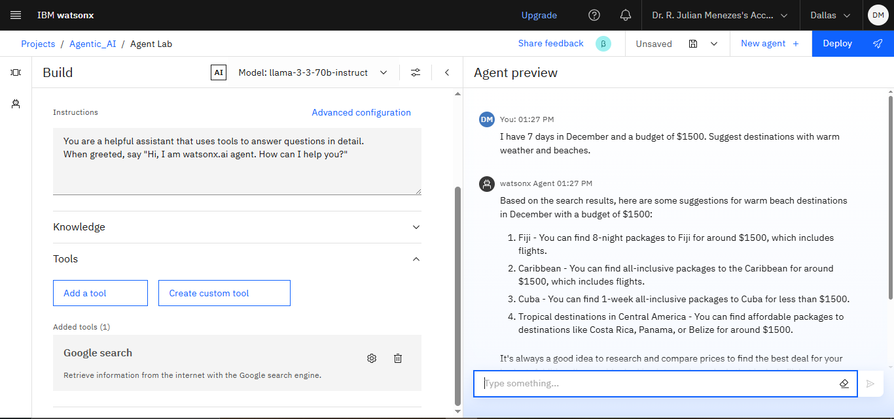
Results

Slide 17
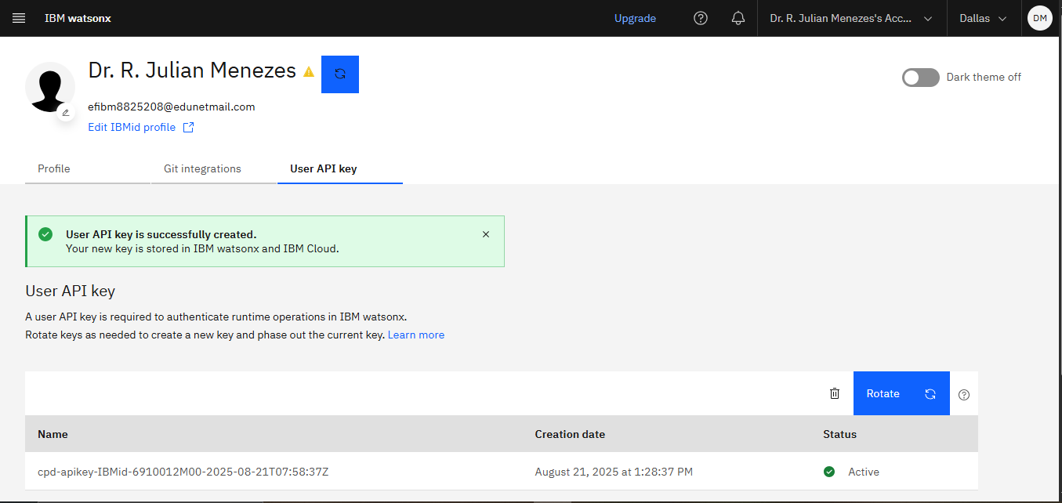
Results

Slide 18
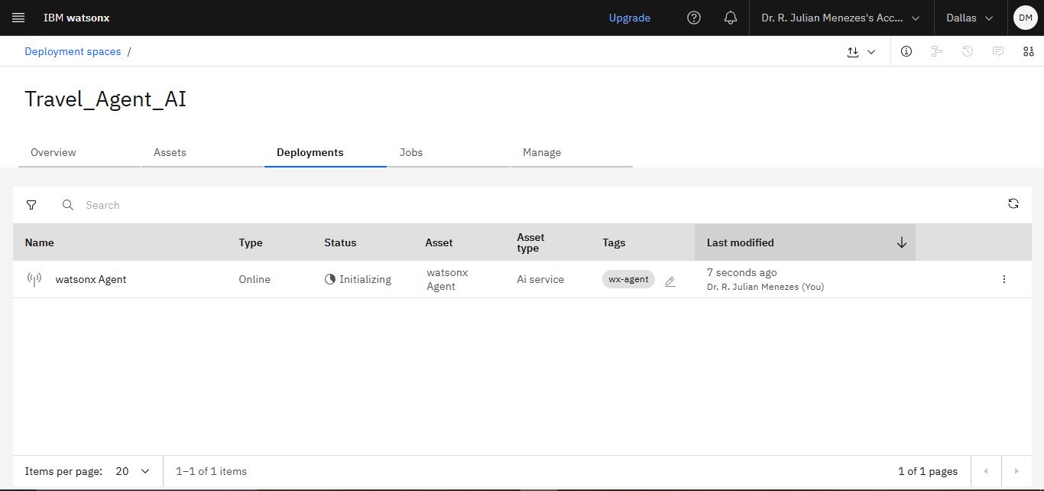
Results

Slide 19
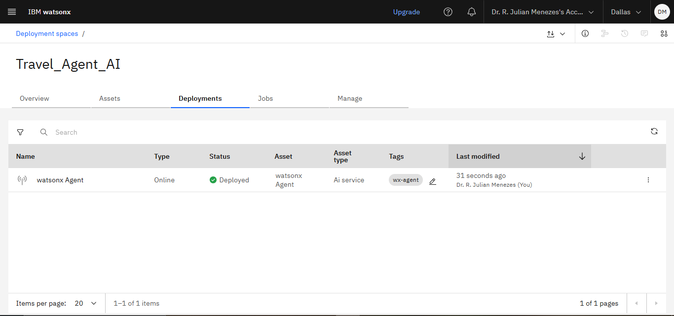
Results

Slide 20
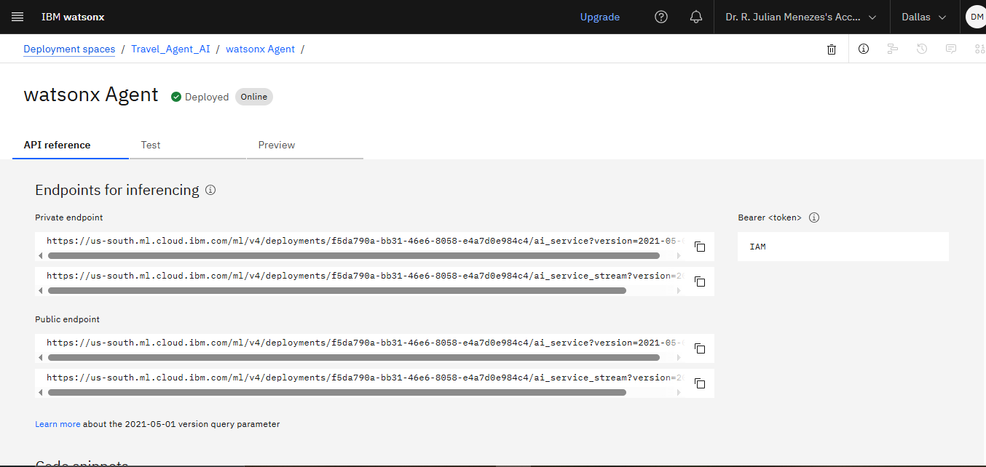
Results

Slide 21
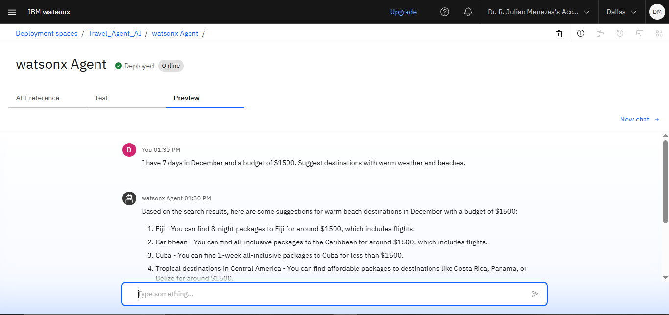
Results

Slide 22
Conclusion
The Travel Planner Agent streamlines the complexity of trip planning by intelligently combining user preferences, real-time data, and smart recommendations.
It not only creates optimized itineraries but also manages bookings, tracks budgets, and adapts dynamically to changes like weather or delays.
By acting as a proactive travel companion, it enhances convenience, personalization, and overall travel satisfaction for individuals and groups alike.

Slide 23
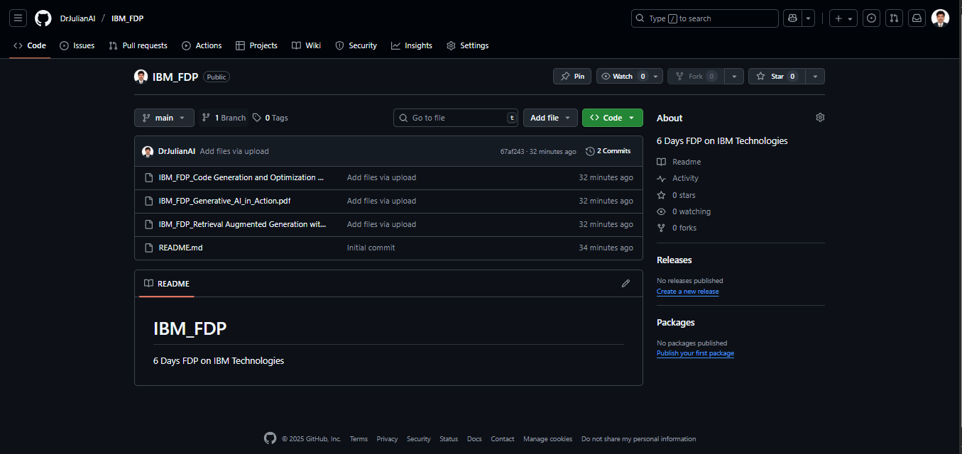
GitHub Link - https://github.com/DrJulianAI/IBM_FDP.git

Slide 24
Future scope
Multilingual Travel Support – Offer assistance in multiple languages for global travelers.
Voice-Activated Travel Assistant – Enable natural conversation and hands-free trip planning via mobile or smart speakers.
Immersive AR/VR Previews – Let users explore destinations virtually before booking.
Integration with Smart Wearables – Deliver real-time alerts (gate changes, weather updates) directly to smart watches or AR glasses.
Sustainability-Aware Planning – Suggest eco-friendly travel options and carbon footprint tracking.
Partnerships with Travel Ecosystem – Deep integration with airlines, hotels, and local tourism boards for direct booking and exclusive offers.
AI-Powered Travel Communities – Enable group itineraries, shared experiences, and peer recommendations among like-minded travelers.

Slide 25
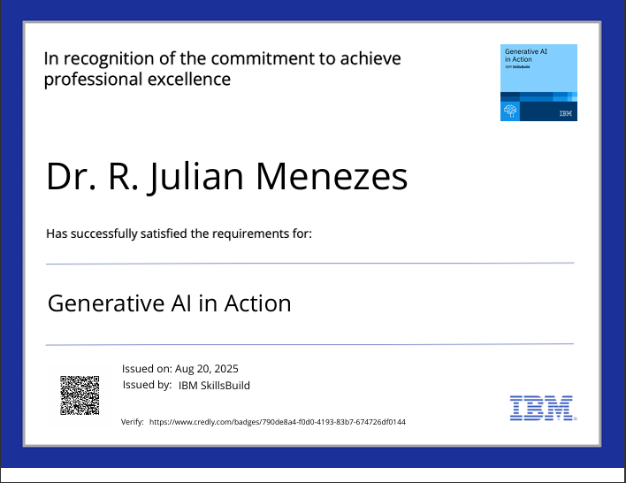
IBM Certifications

Slide 26
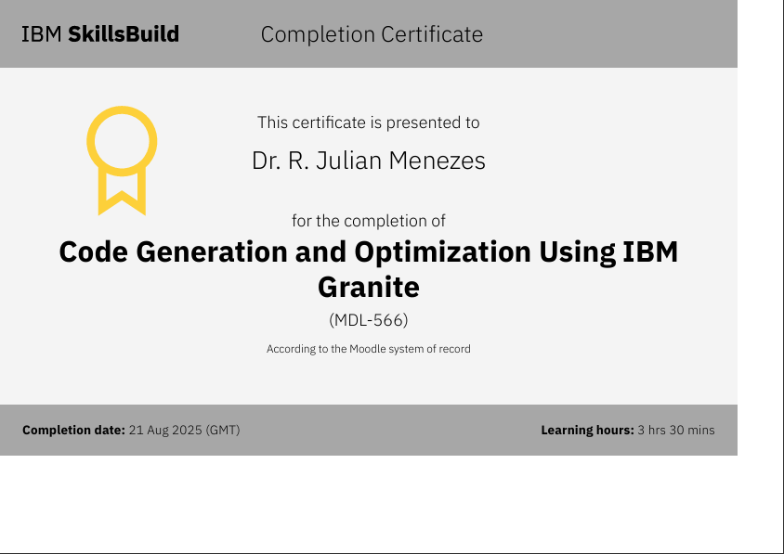
IBM Certifications

Slide 27
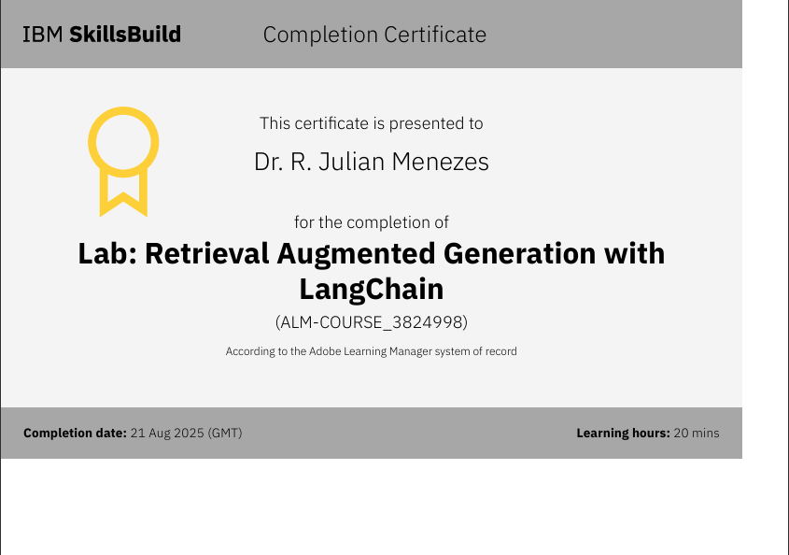
IBM Certifications

Slide 28
Problem – Solution – Impact Summary
Problem:-
Trip planning is time-consuming and fragmented across multiple platforms (flights, hotels, maps, weather, and activities).
Travelers face unexpected disruptions (delays, cancellations, bad weather) with little real-time support.
Generic itineraries fail to match individual preferences, budgets, or group needs.

Slide 29
Problem – Solution – Impact Summary
Solution – Travel Planner Agent:
An AI-powered assistant built on IBM Granite + IBM Cloud Lite Services.
Creates personalized itineraries based on user preferences, budgets, and constraints.
Integrates real-time data (weather, maps, bookings, alerts) for adaptive travel planning.
Provides a collaborative platform for groups, managing conflicts and merging preferences.
Acts as a proactive travel concierge — not just planning trips, but optimizing them on the go.

Slide 30
Problem – Solution – Impact Summary
Impact:
For Travelers: Hassle-free, customized, and reliable trip planning.
For Businesses: Travel agencies, corporates, and tourism providers gain efficiency and new engagement channels.
For Communities: Promotes sustainable tourism by suggesting eco-friendly options and hidden local gems.

Slide 31
THANK YOU

